Slide 1
Reading Electrical Schematics
These basic tutorials start with electrical symbols and schematic design and proceed to include the specific schematics for the production machines you use in your plant. They are designed to help you use an electrical schematic to work your way through any problem that may occur during the manufacturing process.
Being able to read and understand an electrical schematic is the fastest
way to solve an electrical problem. We suggest that you start with the tutorial named What is an Electrical Schematic, to help you understand what some of the electrical symbols represent and how the electrical schematics work. The tutorials will run automatically in Windows® Media Player.
You can pause, go forward, or go backward during the presentation. When finished, just close Media Player. Each module takes about ½ hour to complete.
What Is an Electrical Schematic?

Slide 2






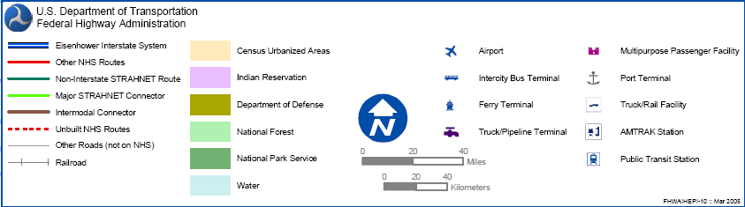
Reading Electrical Schematics
CB2
10A
480 VAC
CB3
10A
XFR
1
X1
X2
1
120 VAC
E-Stop
Start
PB1
PB2
1
3
4
OL
GRD
2
M Aux
RUN
3
CR
4,
CR
1
5
U SOL.
4

Slide 3
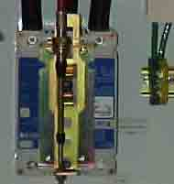
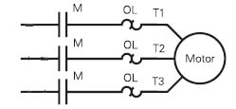
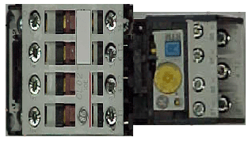
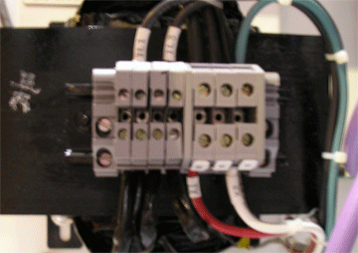
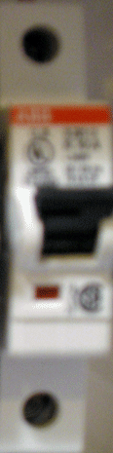
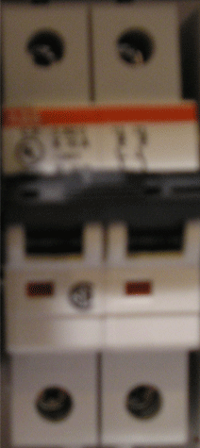
480 VAC
CB1
30A
L1
L2
L3
3 pole circuit breaker
CB2
10A
480 VAC
CB3
10A
XFR
2 pole circuit breaker
Motor starter
With overload attached
1
X1
120 VAC
X2
GRD
Single pole circuit breaker
Control transformer
Reading Electrical Schematics

Slide 4
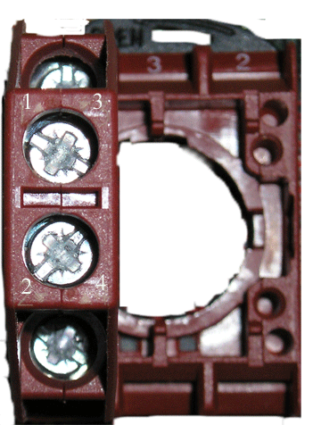
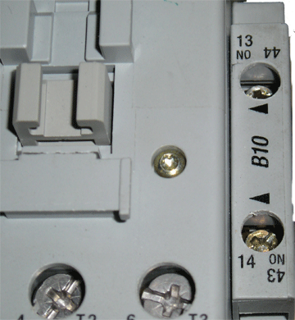
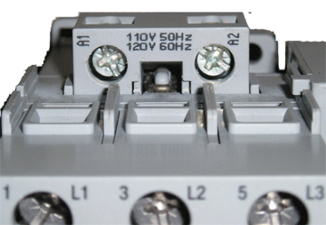
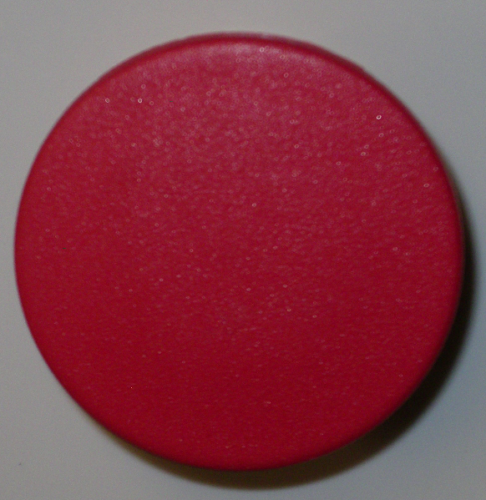
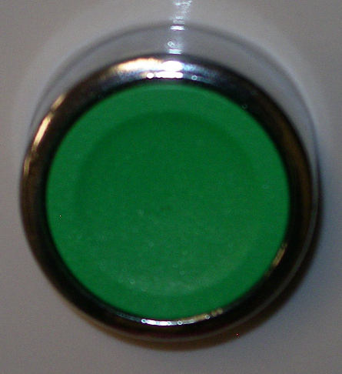
Reading Electrical Schematics
480 VAC
CB1
30A
L1
L2
L3
CB2
10A
480 VAC
CB3
10A
XFR
1
X1
120 VAC
X2
E-Stop
Start
PB1
PB2
1
3
4
4
GRD
(1)
(2)
(3)
(4)
(A1)
M Aux
(13)
(14)
1
CR
5
(A1)
(11)
(14)
WIRING
Terminal on that device
(#) (A#)

Slide 5
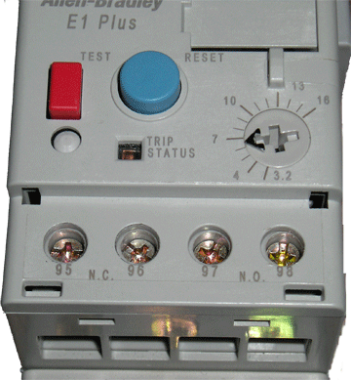
Reading Electrical Schematics
480 VAC
CB1
30A
L1
L2
L3
CB2
10A
Screw terminals for the coil
on the motor starter
480 VAC
CB3
10A
XFR
1
X1
120 VAC
X2
E-Stop
Start
PB1
PB2
OL
1
3
4
GRD
(1)
(2)
(3)
(4)
(A1)
(A2)
(96)
(95)
M Aux
Overload relay
(13)
(14)
1
CR
5
(A1)
(A2)
(11)
(14)
Screw terminals 95 and
on the overload relay NC
means normally closed
WIRING
Terminal on that device
(#) (A#)
96

Slide 6

480 VAC
CB1
30A
Running the circuit
L1
L2
L3
CB2
10A
480 VAC
CB3
10A
XFR
1
X1
120 VAC
X2
1
E-Stop
Start
PB1
PB2
2
1
3
4
GRD
Hydraulic cylinder
(1)
(2)
(3)
(4)
(A1)
(A2)
(96)
(95)
M Aux
RUN
3
(13)
(14)
CR
1
CR
4,
5
(A1)
(A2)
U SOL.
4
(11)
(14)
WIRING
Terminal on that device
(#) (A#)

Slide 7
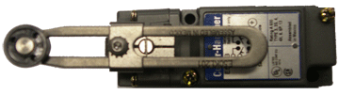

Reading Electrical Schematics
480 VAC
CB1
30A
L1
L2
L3
Limit switch
CB2
10A
480 VAC
CB3
10A
XFR
1
X1
120 VAC
X2
1
E-Stop
Start
PB1
PB2
OL
1
3
4
GRD
2
(1)
(2)
(3)
(4)
Up
(A1)
(A2)
(96)
(95)
(13)
M Aux1
M Aux
PB3
RUN
(14)
CR2
6
LS1
1a
5
(13)
(14)
7
CR1
CR1
3
(11)
(12)
(3)
(4)
(7)
(8)
3,4,5
CR1
(A1)
(A2)
-
1a
CR1
(21)
(24)
8
U SOL.
4
Down
(11)
(14)
PB4
CR1
LS2
1a
9
10
11
5
CR2
CR2
CR2
(3)
(4)
(11)
(12)
(7)
(8)
(A1)
(A2)
3,5,6
-
(11)
(14)
CR2
6
1a
12
D Sol.
(21)
(24)

Slide 8
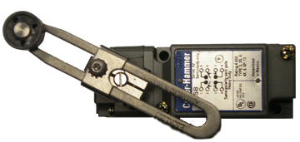

480 VAC
CB1
30A
Test the circuit
L1
L2
L3
LS1
CB2
10A
LS2
480 VAC
CB3
10A
XFR
1
X1
120 VAC
X2
1
E-Stop
Start
PB1
PB2
OL
1
3
4
GRD
2
Hydraulic cylinder
(1)
(2)
(3)
(4)
Up
6
(A1)
(A2)
(96)
(13)
M Aux
PB3
RUN
M Aux1
LS1
(14)
CR2
1a
5
(13)
(14)
7
CR1
CR1
3
(11)
(12)
(3)
(4)
(7)
(8)
3,4,5
CR1
(A1)
(A2)
-
1a
CR1
(21)
(24)
8
U SOL.
4
Down
(11)
(14)
PB4
CR1
LS2
1a
9
10
11
5
CR2
CR2
CR2
(3)
(4)
(11)
(12)
(7)
(8)
(A1)
(A2)
3,5,6
-
(11)
(14)
CR2
6
1a
12
D Sol.
(21)
(24)

Slide 9

Reading Electrical Schematics
480 VAC
CB1
30A
L1
L2
L3
CB2
10A
480 VAC
CB3
10A
XFR
1
X1
120 VAC
X2
1
E-Stop
Start
PB1
PB2
OL
1
3
4
GRD
2
(1)
(2)
(3)
(4)
Up
(A1)
(A2)
(96)
(95)
(13)
M Aux
PB3
RUN
M Aux1
LS1
(14)
CR2
6
1a
5
(13)
(14)
7
CR1
CR1
3
(11)
(12)
(3)
(4)
(7)
3,4,5
CR1
(8)
(A1)
(A2)
-
1a
CR1
(21)
(24)
8
U SOL.
4
Down
(11)
(14)
PB4
CR1
LS2
1a
9
10
11
5
CR2
CR2
CR2
(3)
(4)
(11)
(12)
(7)
(8)
(A1)
(A2)
3,5,6
-
(11)
(14)
CR2
6
1a
12
D Sol.
(21)
(24)

Slide 10




Reading Electrical Schematics
480 VAC
CB1
30A
L1
L2
L3
Symbols
CB2
10A
480 VAC
CB3
10A
XFR
1
X1
X2
OL
Symbols
1
120 VAC
E-Stop
Start
PB1
PB2
2
1
3
4
GRD
(1)
(2)
(3)
(4)
(A1)
(A2)
(96)
(95)
M Aux
RUN
3
(13)
(14)
CR
1
CR
4,
5
(A1)
(A2)
U SOL.
4
(11)
(14)
WIRING
Terminal on that device
(#)

